Slide 1
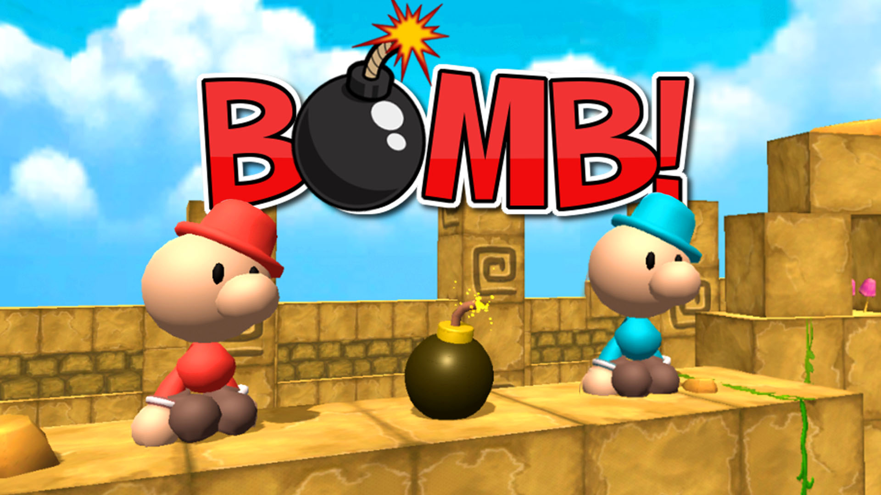
WELCOME!!

Slide 2
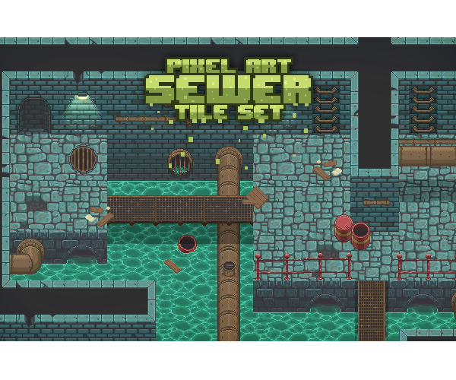
PROJECT PRESENTATION
Trịnh Quang Anh ITITIU19002
Lê Trần Phong ITITIU19180
Nguyễn Ngọc Minh Nhật ITITIU19172

Slide 3
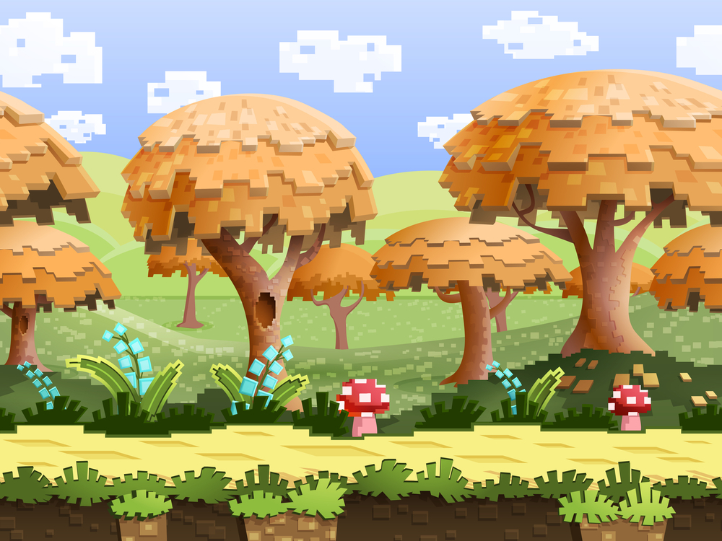
OUTLINE
1. Game rules, features/ mechanism
2. Graphical Design
3. MVC,Design patterns, principles
4. Future Updates

Slide 4
GAME RULES, FEATURES, MECHANISM
1

Slide 5
GAME RULES
1. Moving characters to place bomb 💣
2. Kill the monsters before they try to kill you 🎃
3. Getting items to get stronger

Slide 6
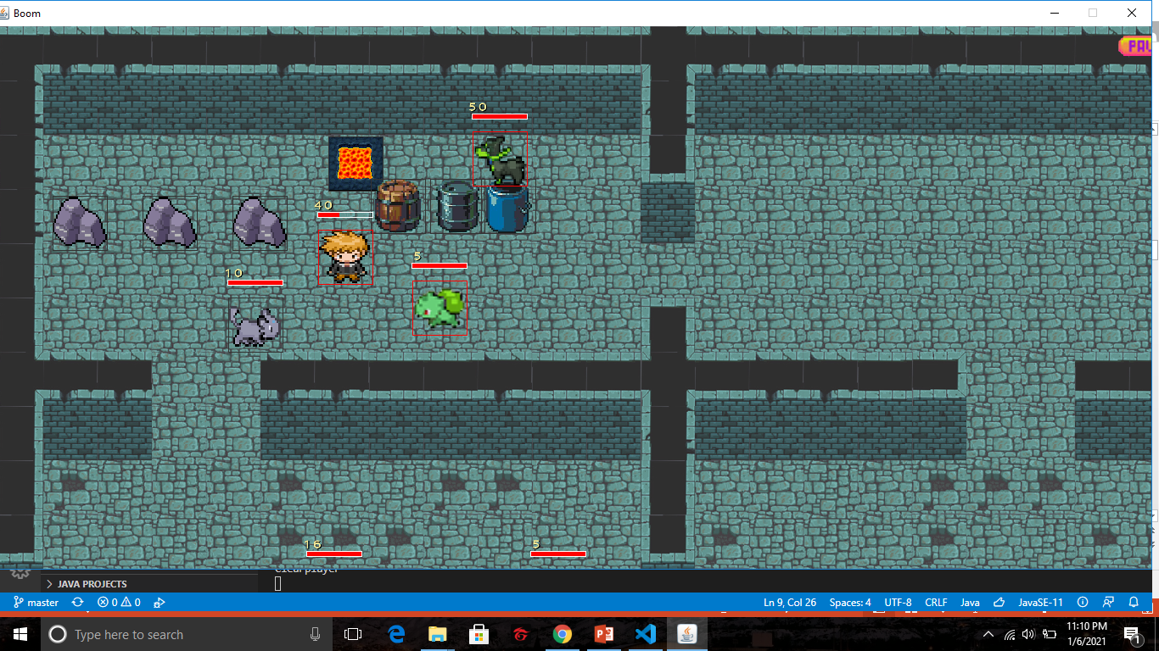
FEATURES
Players
Monsters
Items
Tiles
Bombs
Explosions

Slide 7
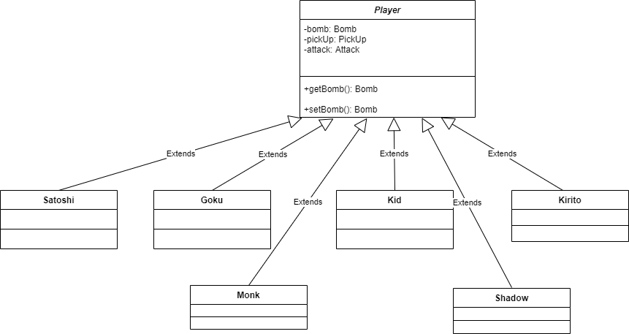
Players

Slide 8
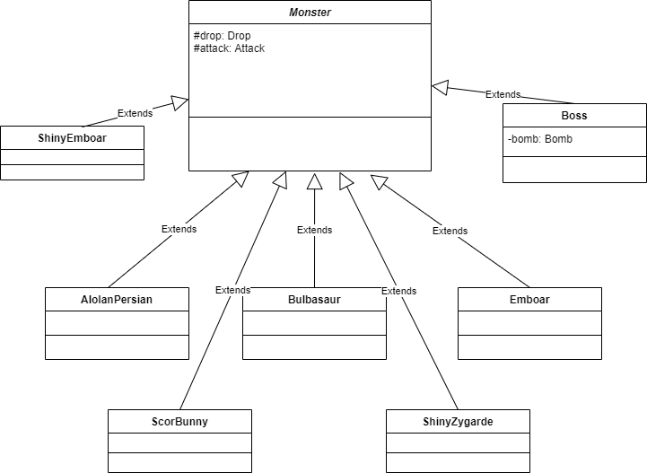
Monsters

Slide 9
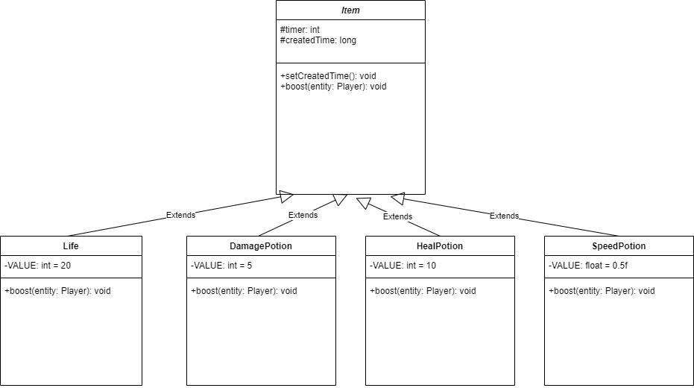

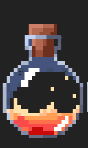
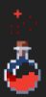
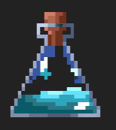
Items

Slide 10
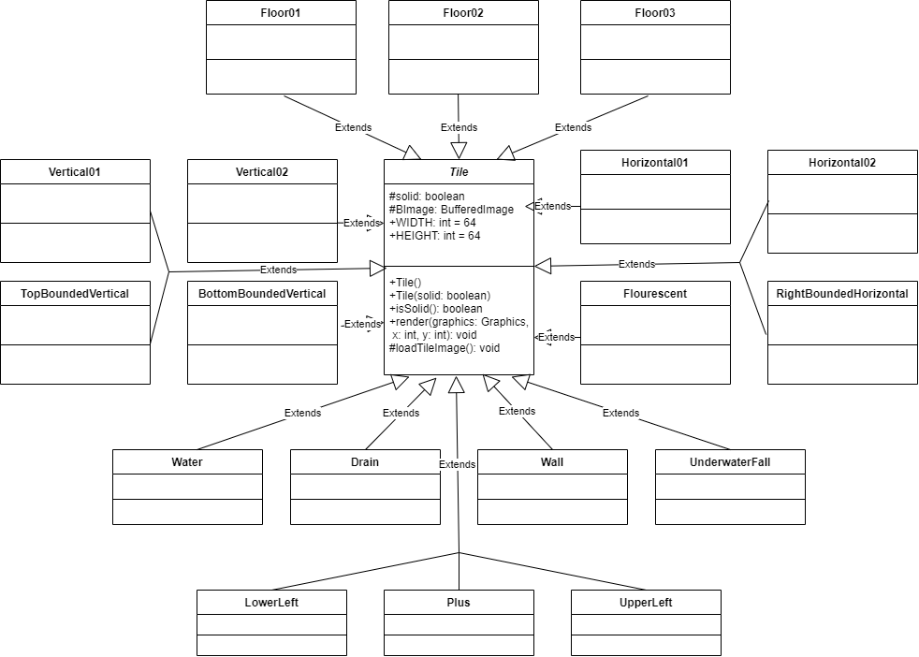
Tiles

Slide 11
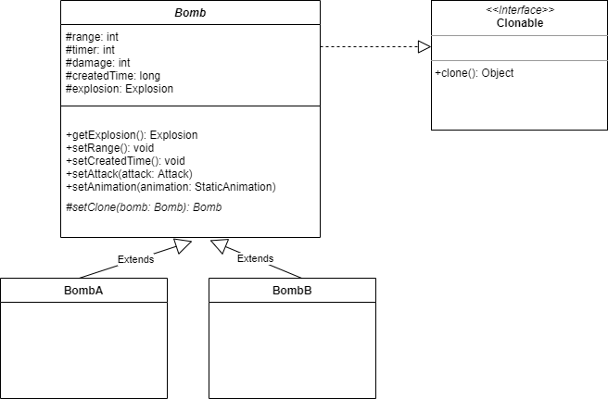
Bombs

Slide 12

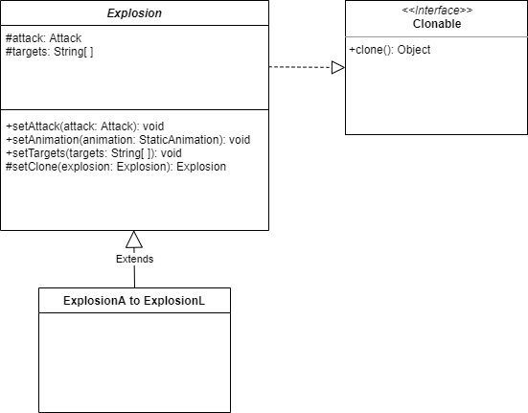

Explosions

Slide 13
MECHANISM
Animations
Collisions
Attack
Drop
Pick Up
Move

Slide 14
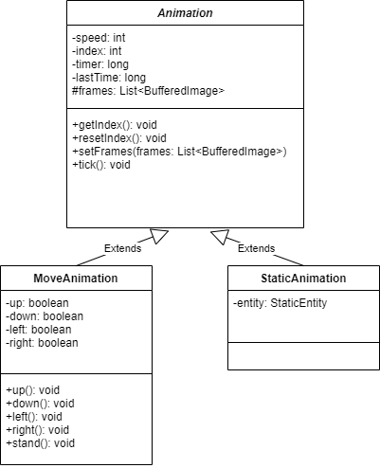
Animations

Slide 15
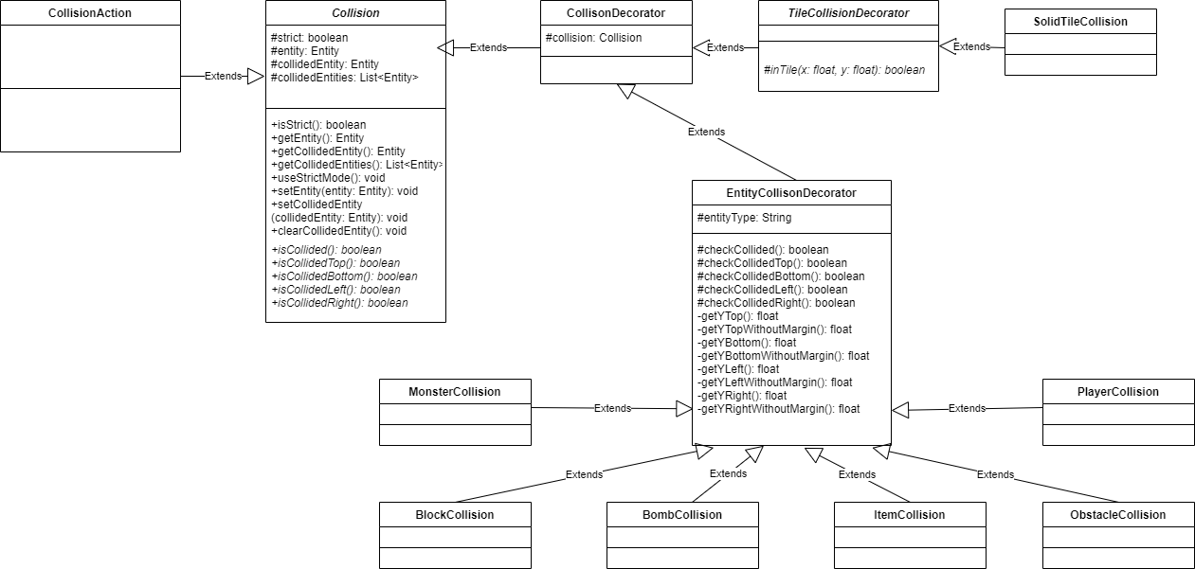
Collision

Slide 16
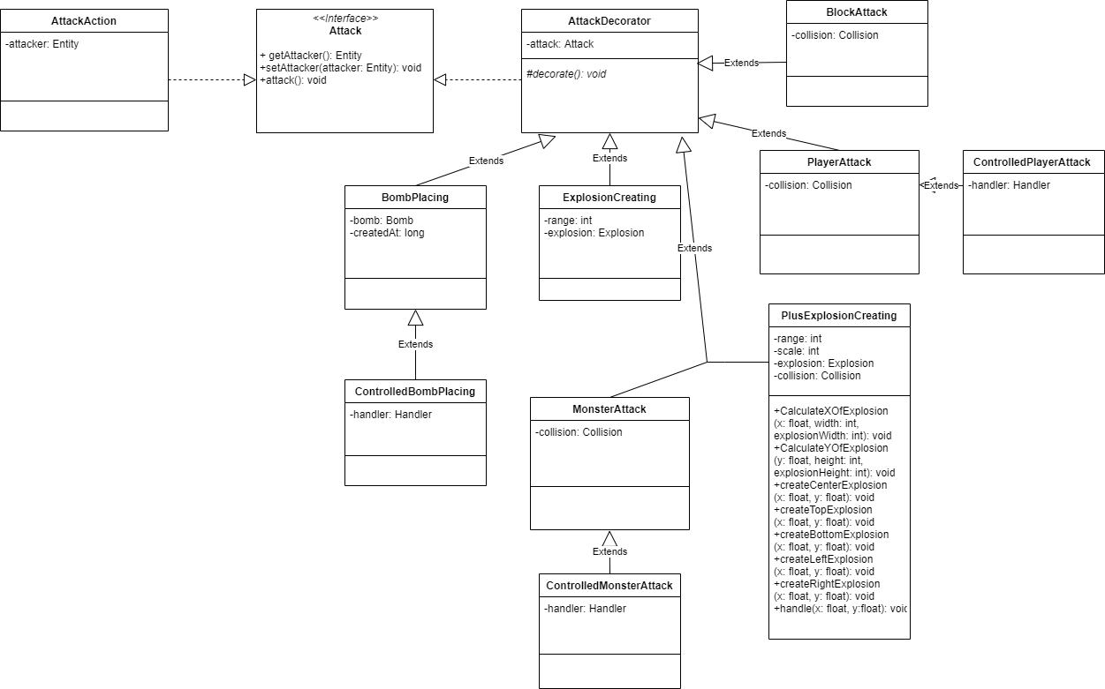
Attack

Slide 17
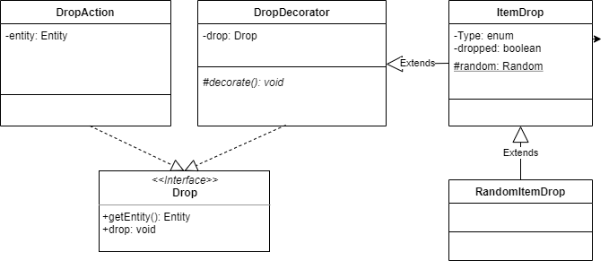
Drop

Slide 18
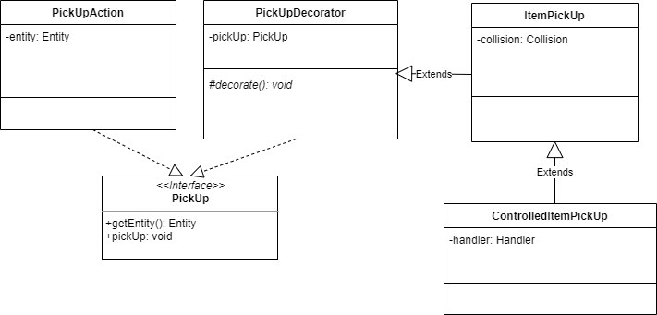
Pick Up

Slide 19
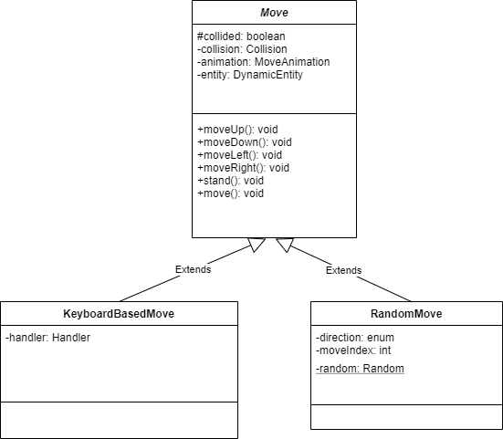
Move

Slide 20
GRAPHICAL DESIGN
2

Slide 21
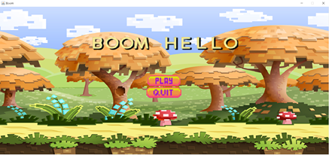
HOME SCREEN

Slide 22
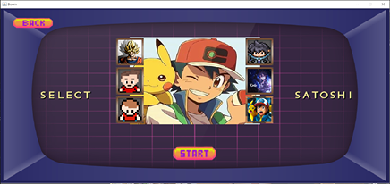
CHARACTER SELECTION SCREEN

Slide 23
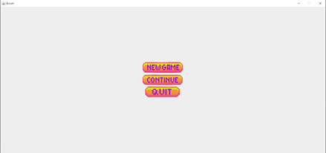
PAUSE SCREEN

Slide 24
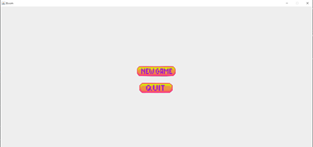
GAME OVER SCREEN

Slide 25
MVC, DESIGN PATTERNS, PRINCIPLES
3

Slide 26
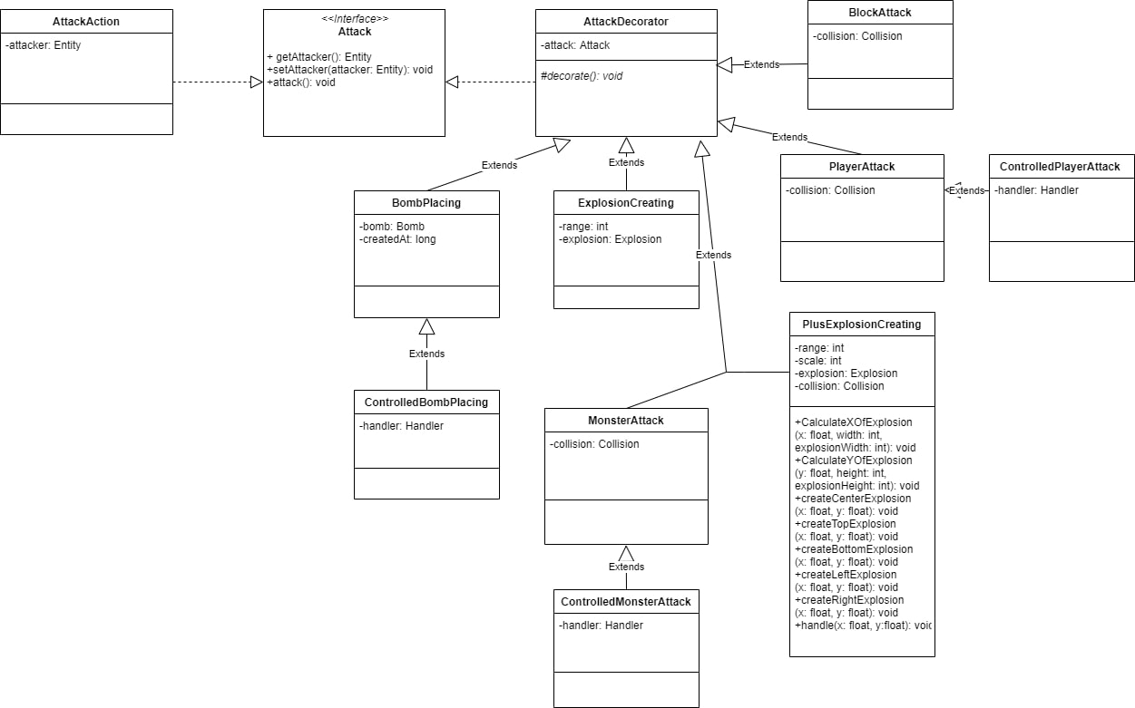
DESIGN PATTERN
Decorator Design Pattern

Slide 27
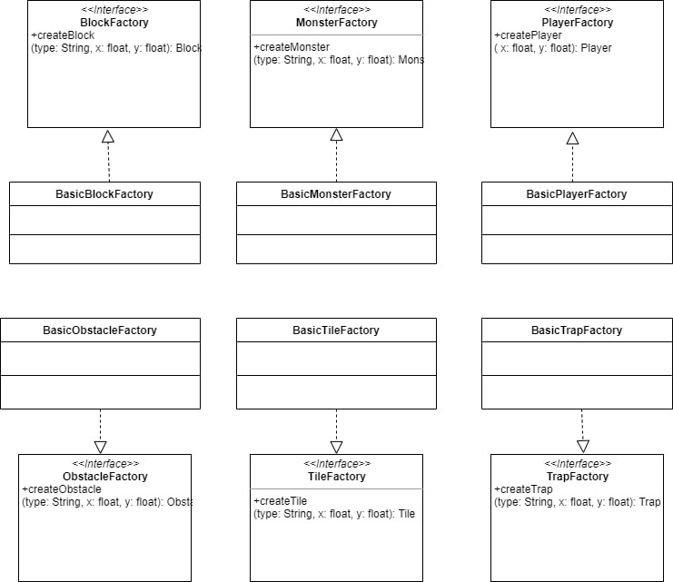
DESIGN PATTERN
Factory Method Design Pattern

Slide 28
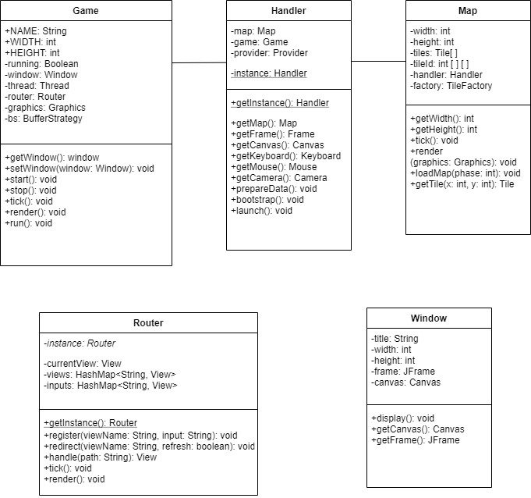
DESIGN PATTERN
Singleton Design Pattern

Slide 29
DESIGN PATTERN
Prototype Design Pattern

Slide 30
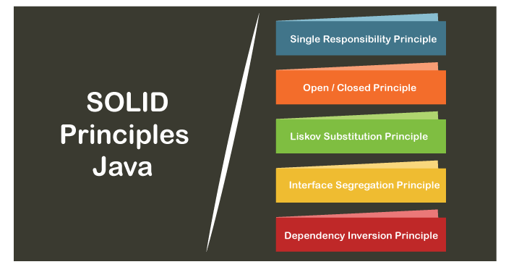
PRINCIPLES

Slide 31
4
FUTURE UPDATES

Slide 32
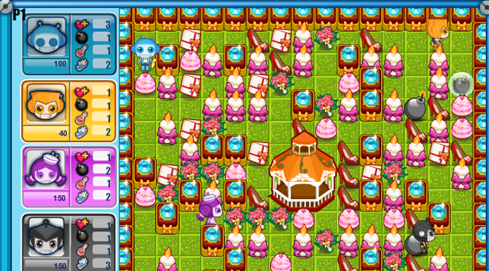
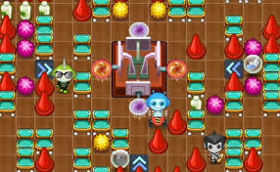
Update new features and mechanisms

Slide 33
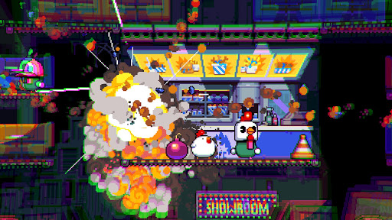
Reinforcement of Game Graphics and other Gameplay features

Slide 34
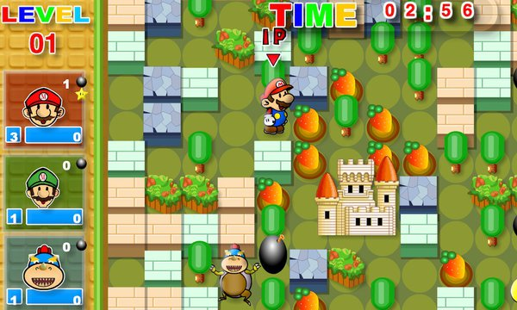
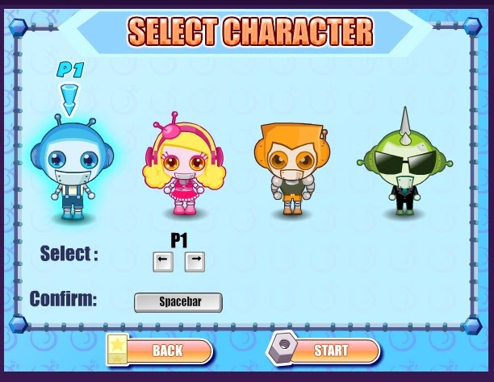
Approaching to an Online Multiplayer Game

Slide 35

GITHUB REPOSITORY, REFERENCES

Slide 36
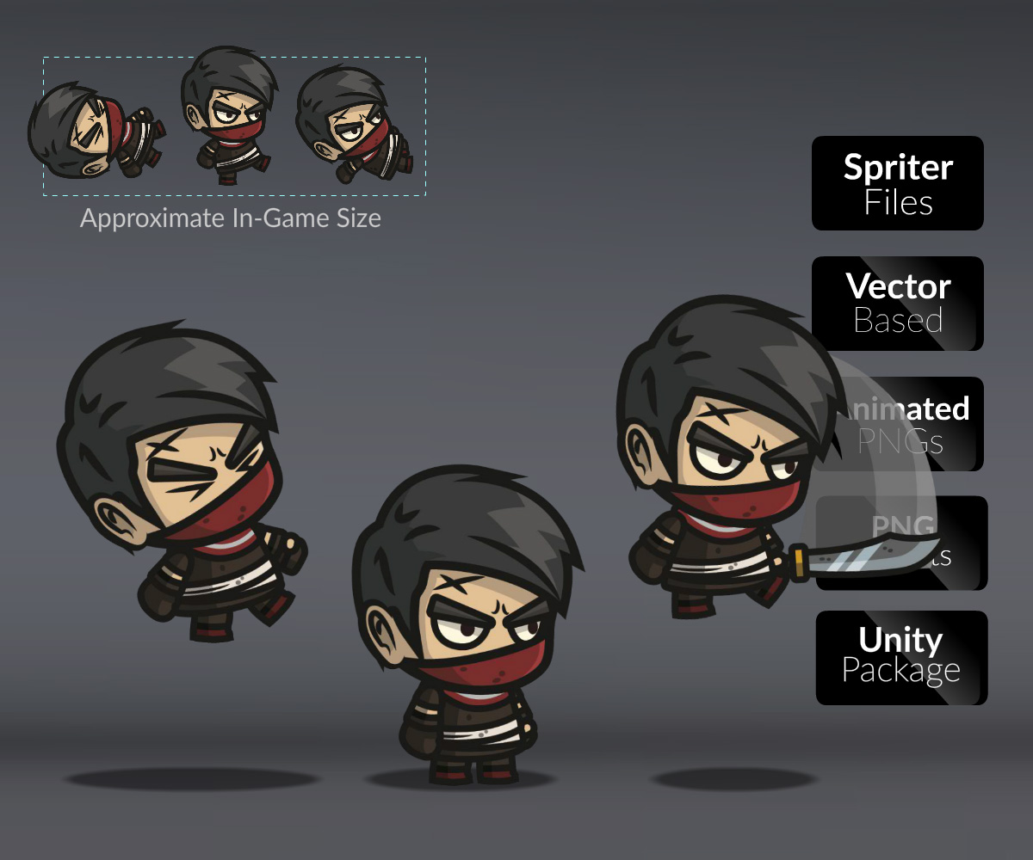

Links
GitHub Repository Link
https://github.com/TP-O/boom
Youtube
https://bitly.com.vn/e330b9
Design Pattern references
https://sourcemaking.com/
Image
https://cartoonsmart.com/

Slide 37
